Slide 1


Slide 2
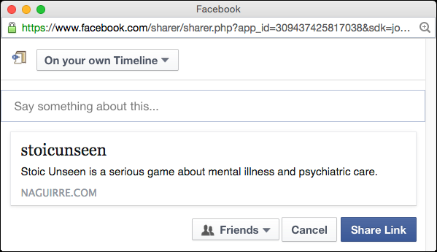

User encounters Stoic Unseen from a Facebook/Social Media post. It catches his/her attention.
!

Slide 3
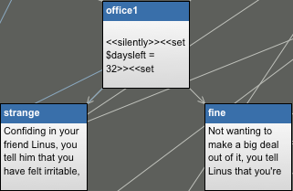
The user plays through the game, making difficult decisions and empathizing with the protagonist

Slide 4


At the end of the game, the user realizes that events depicted in the game reflect the reality that some live.
The user should feel compelled to spread awareness by sharing the link. They might also donate to NAMI.

